Slide 1
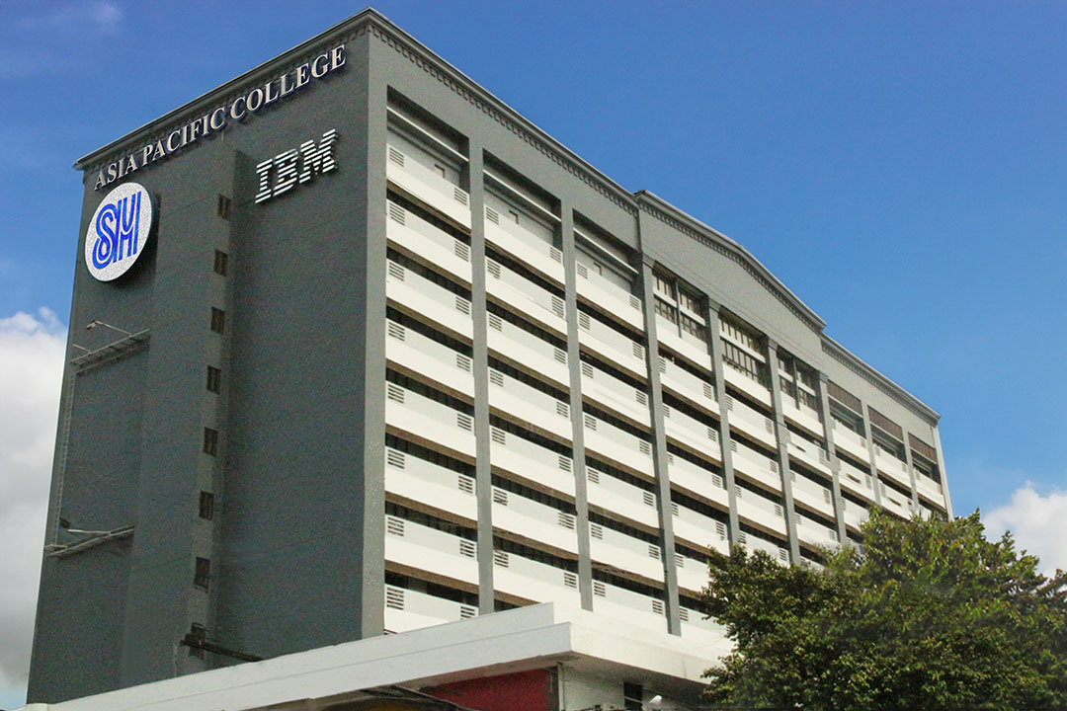

Flight Path
AI-Powered Assessment and Personalized Recommendation
By: Group 10 - WASD

Slide 2
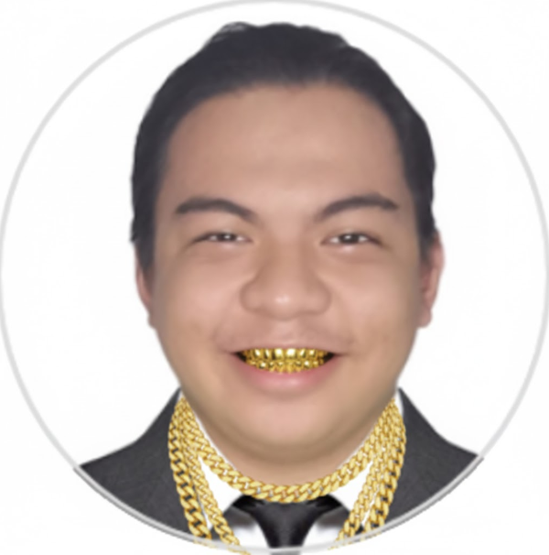
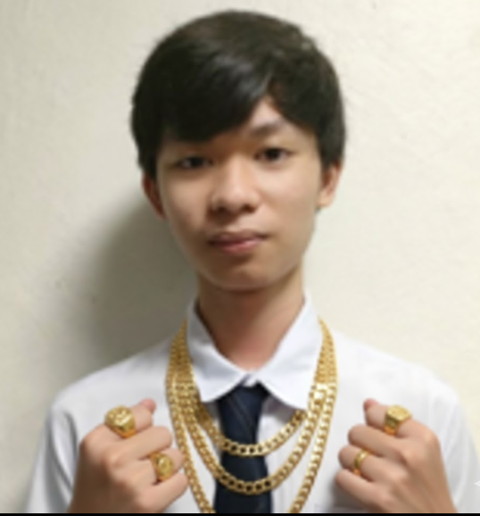
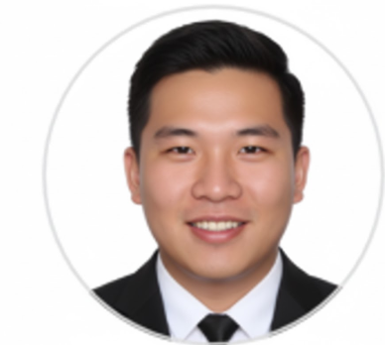
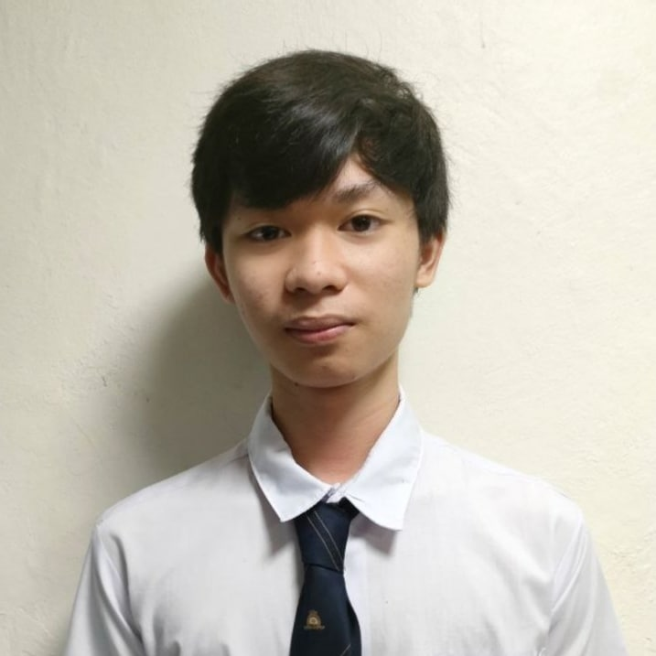
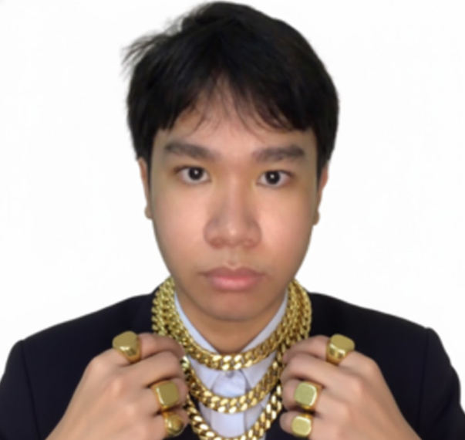

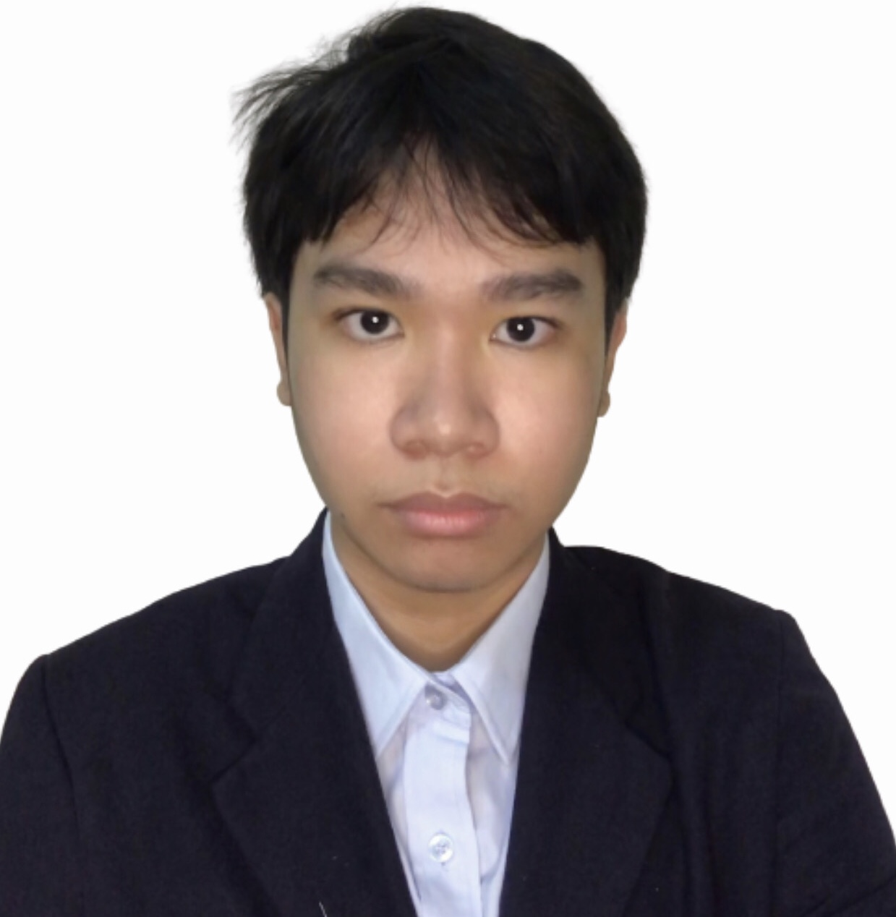
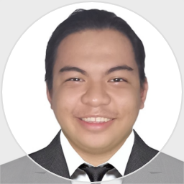


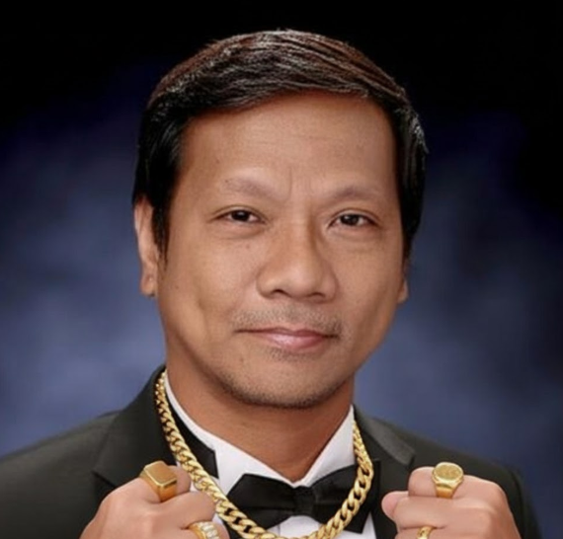
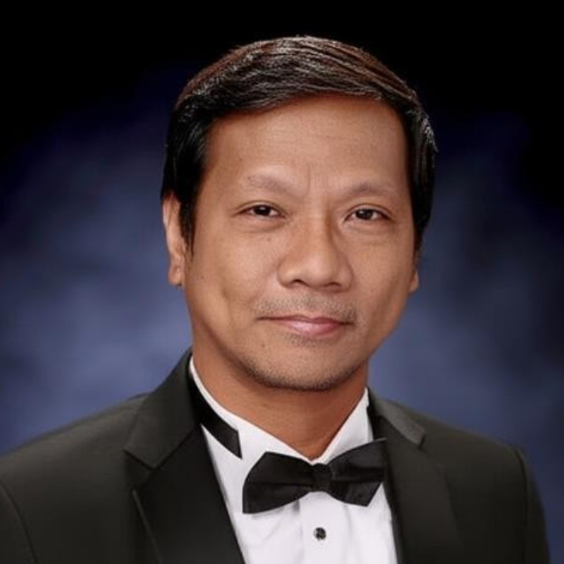

Our Team
Andrei Luis Torres
Justin Bryden Arroco
Don Victor Idos
John Michael Maala
Scrum Master, Project Leader, Developer
Product Assistant, Developer
Product Owner, Developer
Secretary, Developer
Felino Calderon
Manuel L. Calimlim, Jr.
Project Adviser
Project Consultant

Slide 3

Competitive Edge
Innovative Solutions
Focus on Customer Needs
We invest heavily in R&D to develop cutting-edge products and services that meet evolving customer needs.
By prioritizing customer satisfaction and engagement, we create long-lasting relationships and build trust.
Strategic Partnerships
Sustainability Initiatives
Collaborations with key industry players enhance our market reach and technological capabilities.
Our dedication to sustainable practices resonates with environmentally conscious consumers.

Slide 4
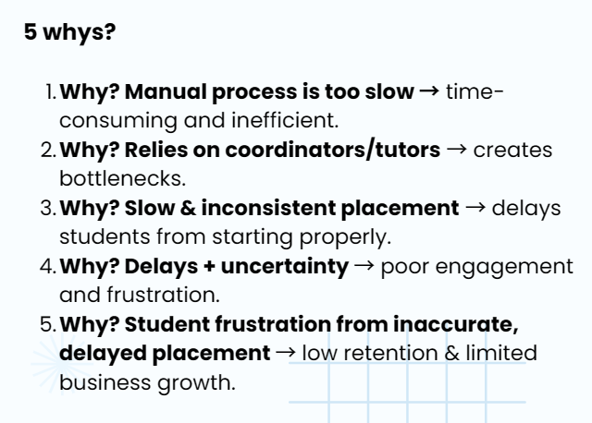
Midterm Output Comments Matrix
Andrei Luis Torres
Root Cause Analysis (Connect the reasons to one another)
MIDTERMS
Problem: UpsWing! Needs to automate its assessment process.
Why 1: The process is slow
Why 2: Because it is done manually
Why 3: Because tutors must handle each assessment by hand and they cannot keep up with the number of new request.
Why 4 (Root Cause): Because is no existing automated system in place to support or replace the manual work

Slide 5
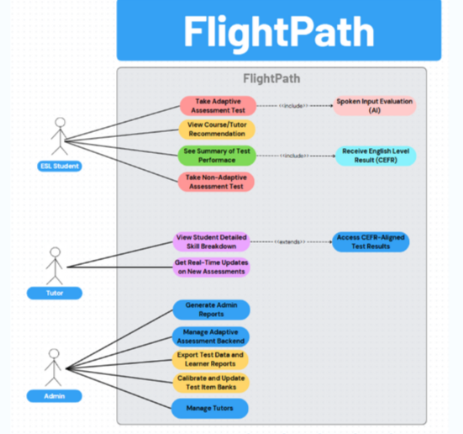
Midterm Output Comments Matrix
Use Case Diagram
MIDTERMS
Andrei Luis Torres

Slide 6
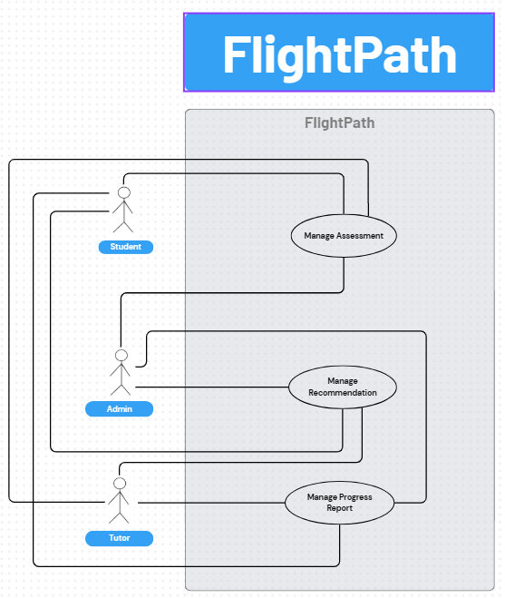
Midterm Output Comments Matrix
Use Case Diagram
Andrei Luis Torres
https://www.canva.com/design/DAGmLZtkIPY/UajwBW4RII09Sm0nQKnV0g/edit

Slide 7
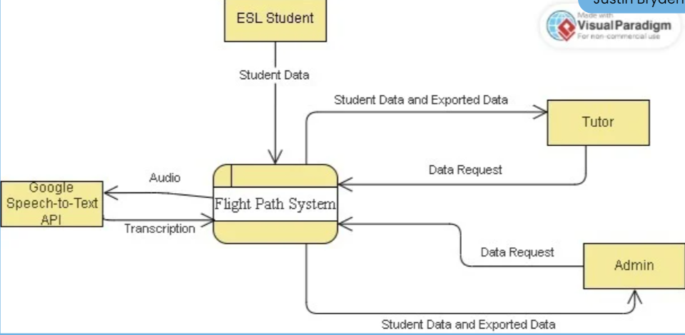
Midterm Output Comments Matrix
Don Victor Idos
Midterms DFD
Level 0

Slide 8
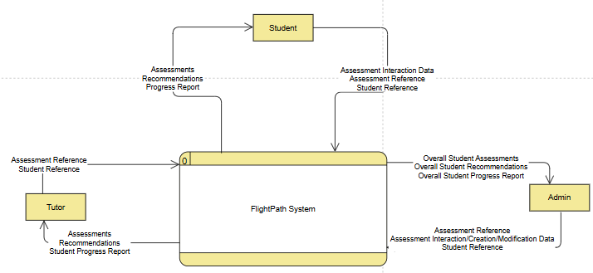
DFD Level 0
Don Victor Idos

Slide 9
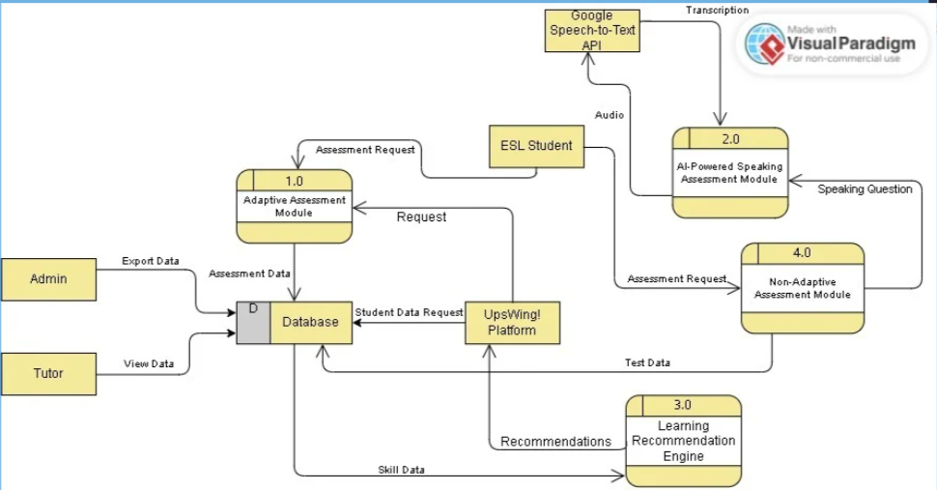
Midterm Output Comments Matrix
Don Victor Idos
Midterms DFD
Level 1

Slide 10
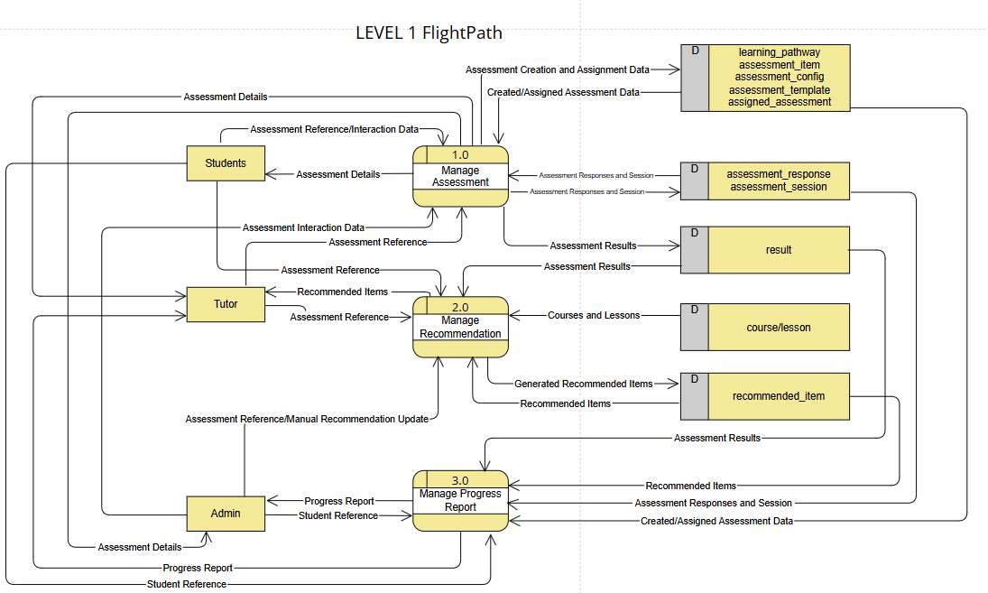
DFD Level 1
Don Victor Idos

Slide 11
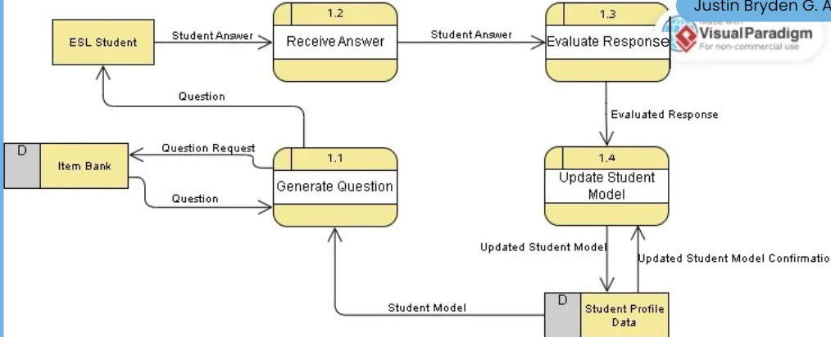
Midterm Output Comments Matrix
Don Victor Idos
Midterms DFD
Level 2

Slide 12
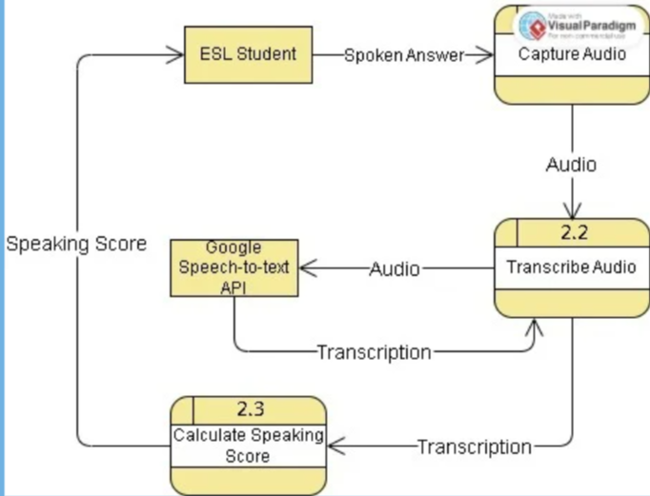
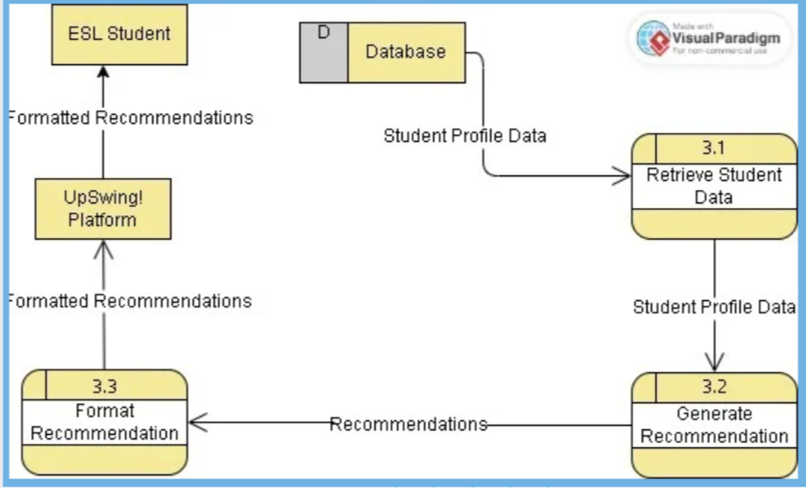
Midterm Output Comments Matrix
Don Victor Idos
Midterms DFD
Level 2

Slide 13
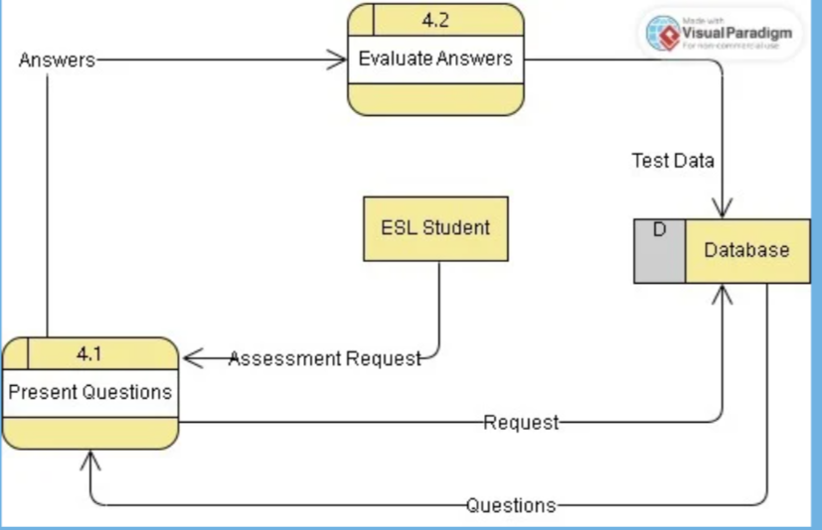
Midterm Output Comments Matrix
Don Victor Idos
Midterms DFD
Level 2

Slide 14
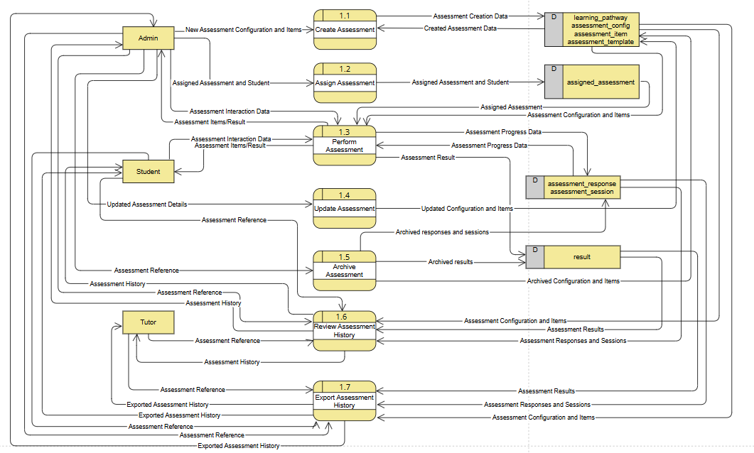
DFD Level 2 – 1.0
Don Victor Idos

Slide 15
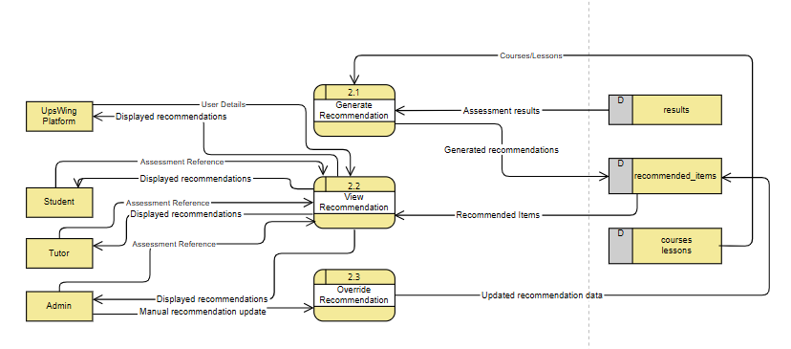
DFD Level 2 – 2.0
JUSTIN BRYDEN ARROCO

Slide 16
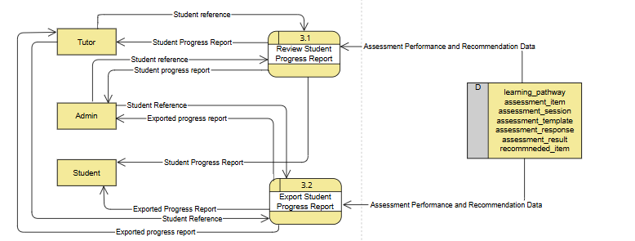
DFD Level 2 – 3.0
JUSTIN BRYDEN ARROCO

Slide 17
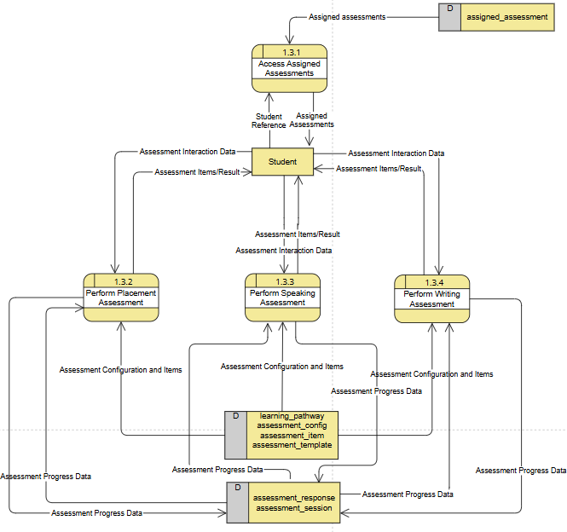
DFD Level 3 – 1.3.x:
JUSTIN BRYDEN ARROCO

Slide 18
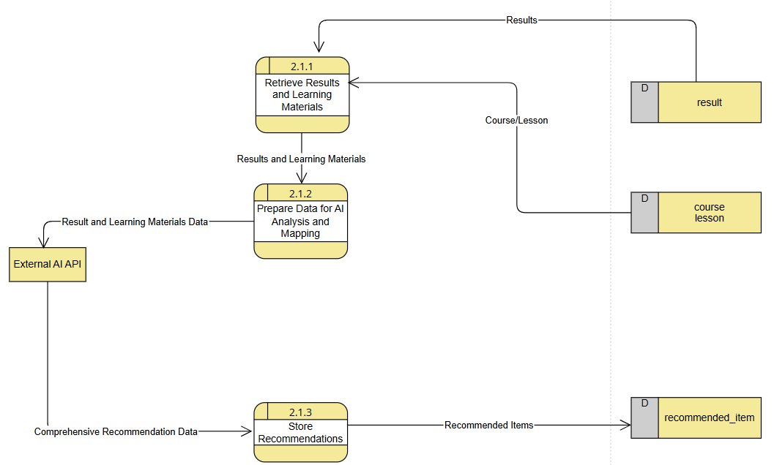
DFD Level 3 – 2.1.x:
JUSTIN BRYDEN ARROCO

Slide 19
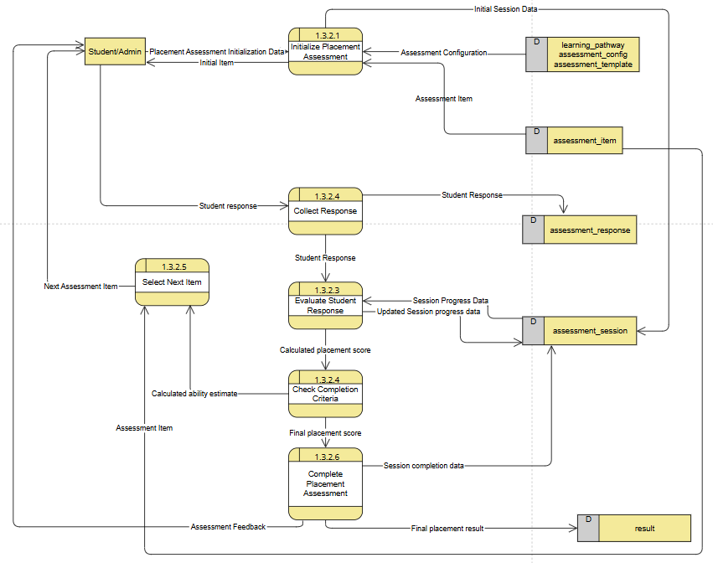
DFD Level 4 – 1.3.2.x
JUSTIN BRYDEN ARROCO

Slide 20
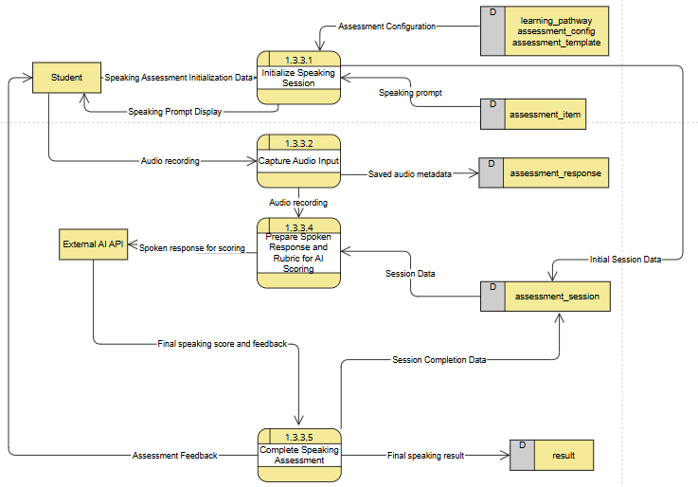
DFD Level 4 – 1.3.3.x
JUSTIN BRYDEN ARROCO

Slide 21
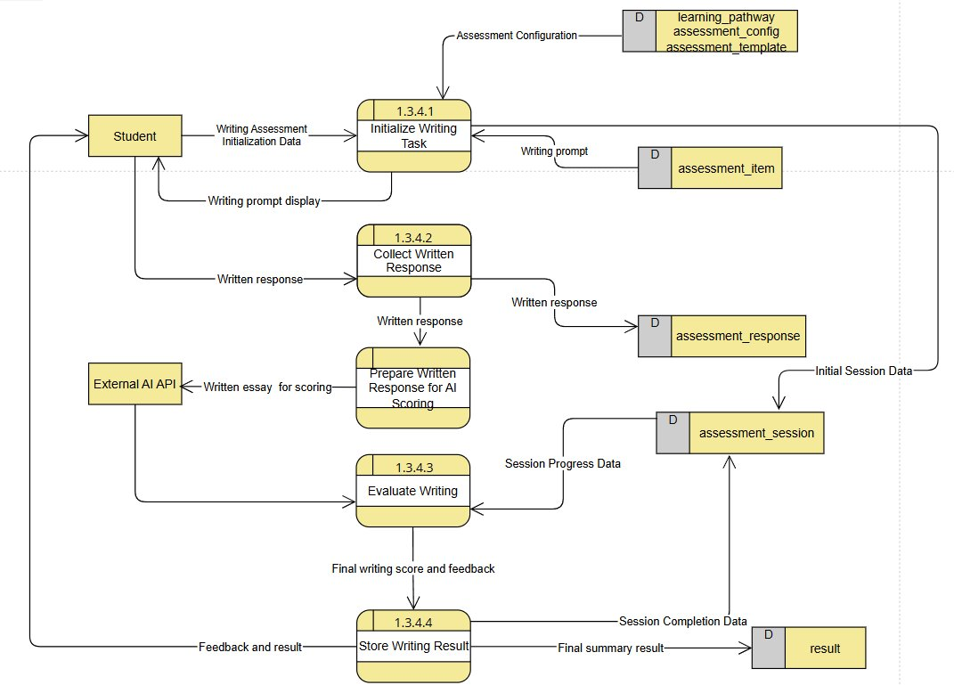
DFD Level 4 – 1.3.4.x
JUSTIN BRYDEN ARROCO

Slide 22
DFD LINKS
JUSTIN BRYDEN ARROCO
DFD Level 0:
DFD Level 1:
DFD Level 2 – 1.0:
DFD Level 2 – 2.0:
DFD Level 2 – 3.0:
DFD level 3 and level 4: https://online.visual-paradigm.com/w/efmbgigt/app/diagrams/#diagram:workspace=efmbgigt&proj=0&id=4&workspace=efmbgigt&type=DataFlowDiagram?themeSketch=1

Slide 23
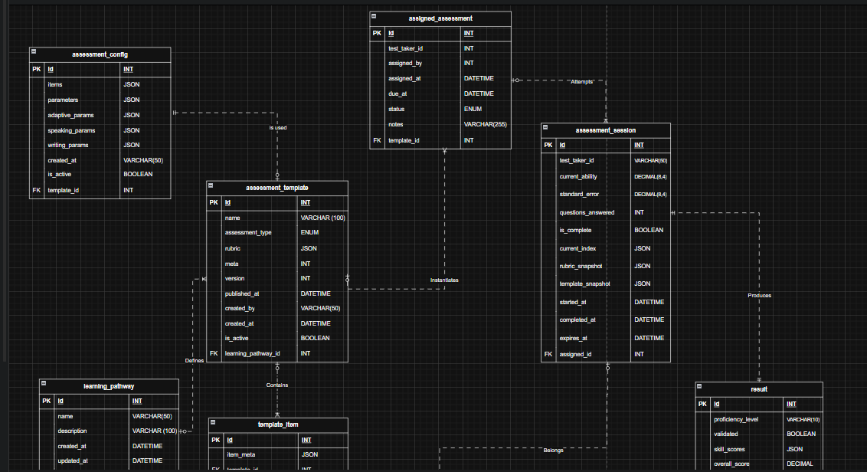
ERD
ERD v2.drawio - Google Drive

Slide 24
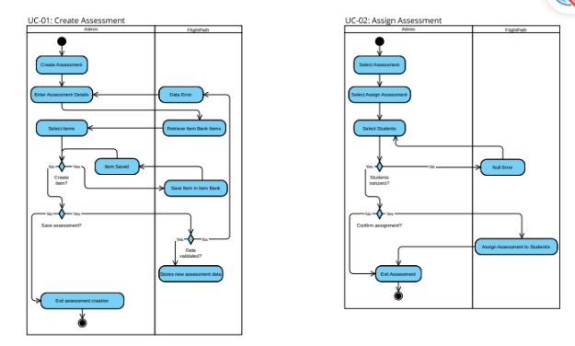
Activity Diagram
JOHN MICHAEL MAALA
Activity Swimlanes Diagram.pdf

Slide 25
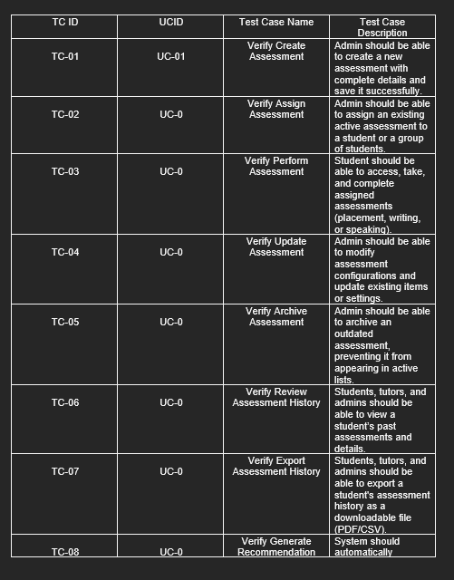
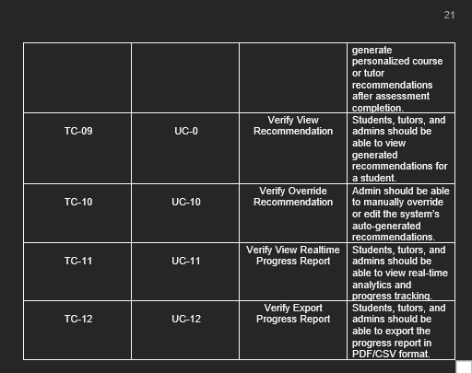
Updated Test Cases
Andrei Luis Torres

Slide 26



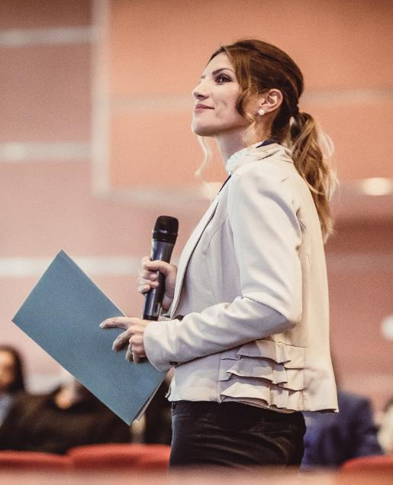
Demo of our Backend
Link to the Github maybe

Slide 27
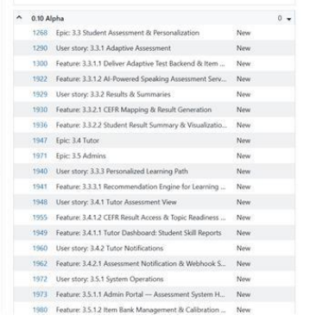
Agile Scrum Sprint 1 Ceremonies: Sprint Planning
Andrei Luis Torres
Assigned Product Owner: Don Victor Idos
Assigned Scrum Master: Andrei Luis Torres
Initial Backlog

Slide 28
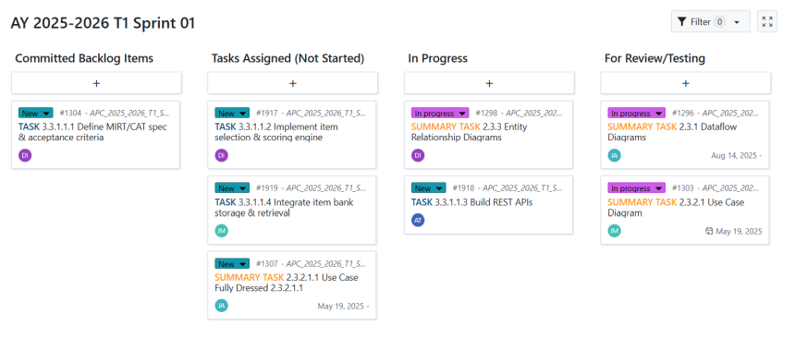
Agile Scrum Sprint 1 Ceremonies: Sprint Planning
Andrei Luis Torres

Slide 29
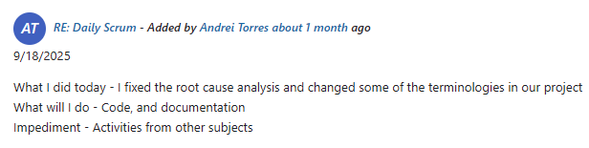
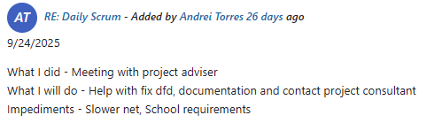
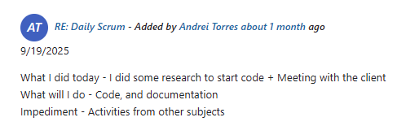
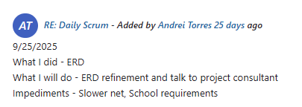
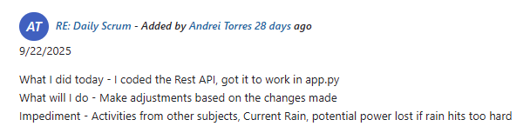
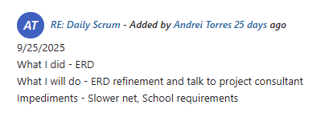
Agile Scrum Sprint 1 Ceremonies: Daily Standup Summary
Andrei Luis Torres

Slide 30
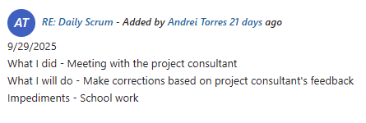
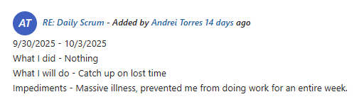
Agile Scrum Sprint 1 Ceremonies: Daily Standup Summary
Andrei Luis Torres

Slide 31
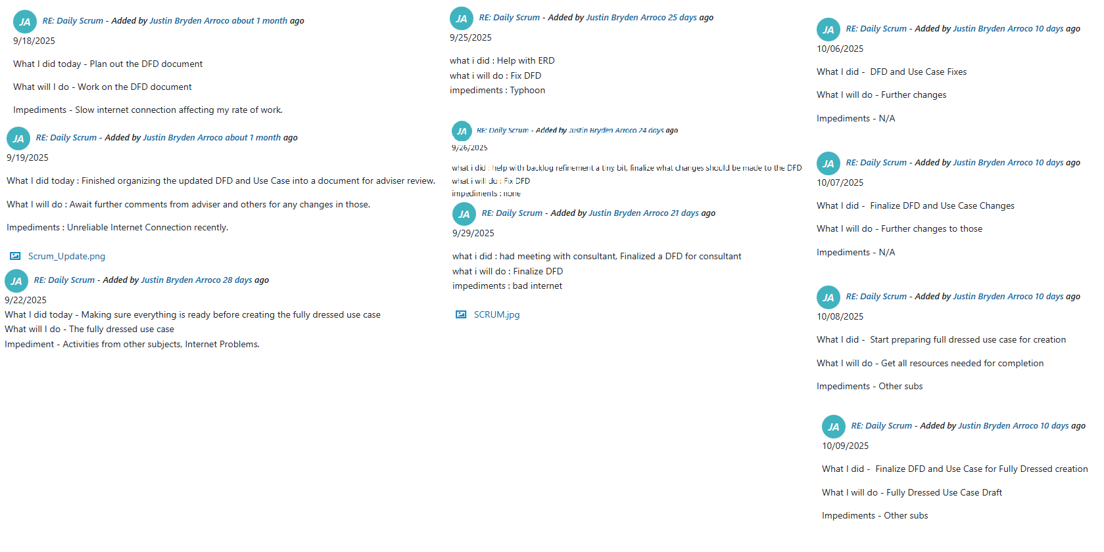
Agile Scrum Sprint 1 Ceremonies: Daily Standup Summary
JUSTIN BRYDEN ARROCO

Slide 32
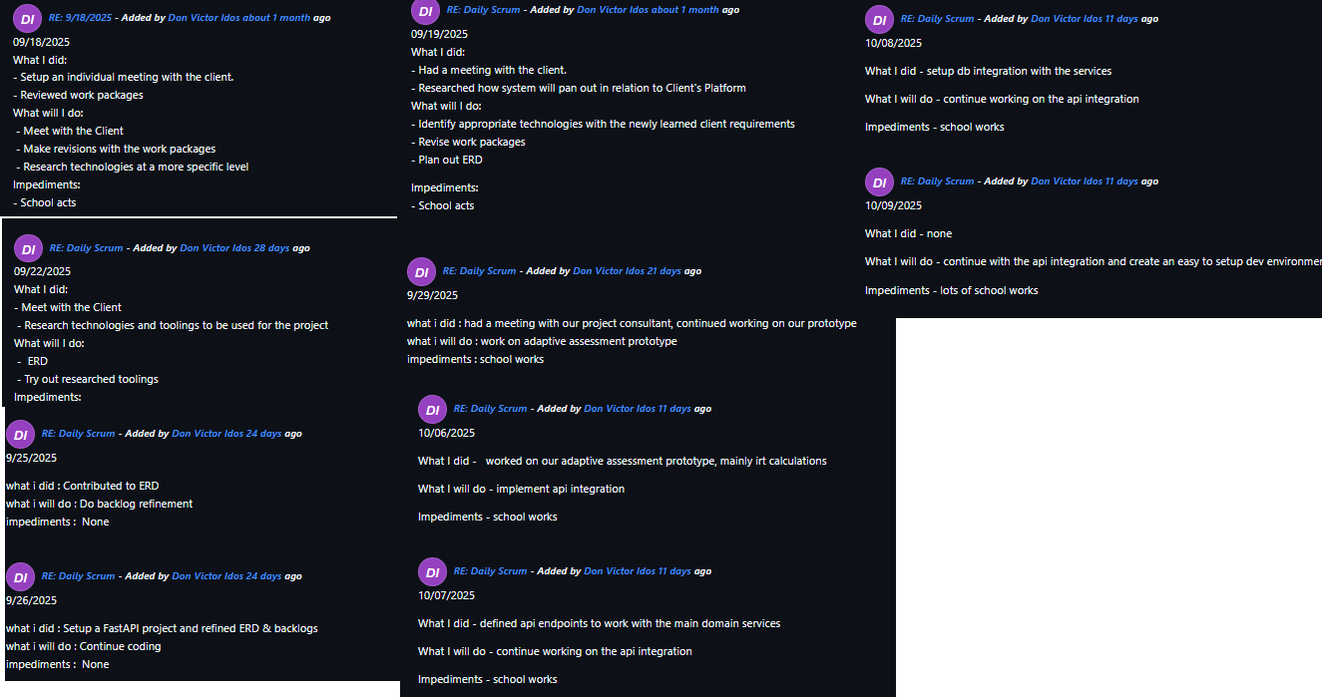
Agile Scrum Sprint 1 Ceremonies: Daily Standup Summary
Don Victor Idos

Slide 33
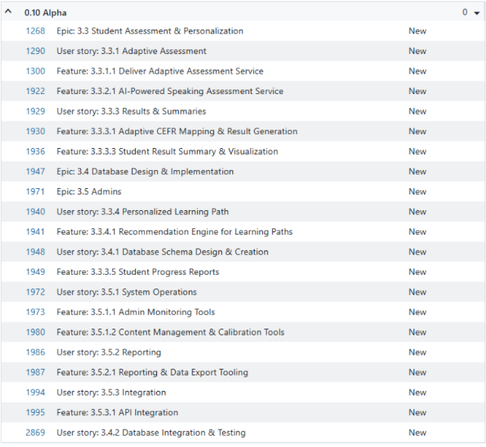
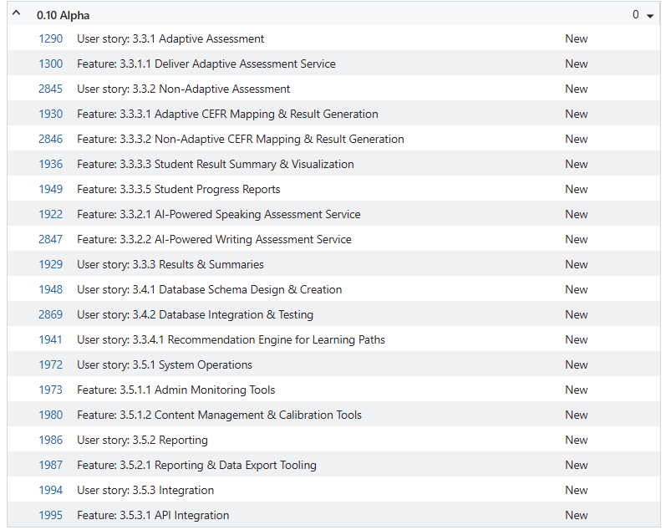
Agile Scrum Sprint 1 Ceremonies: Backlog Refinement
Andrei Luis Torres
Initial
Updated Backlog

Slide 34
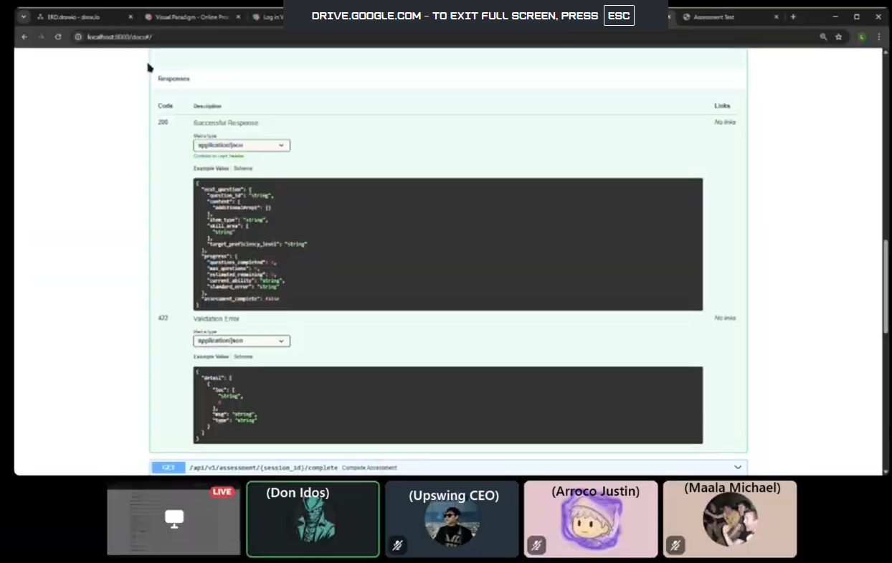
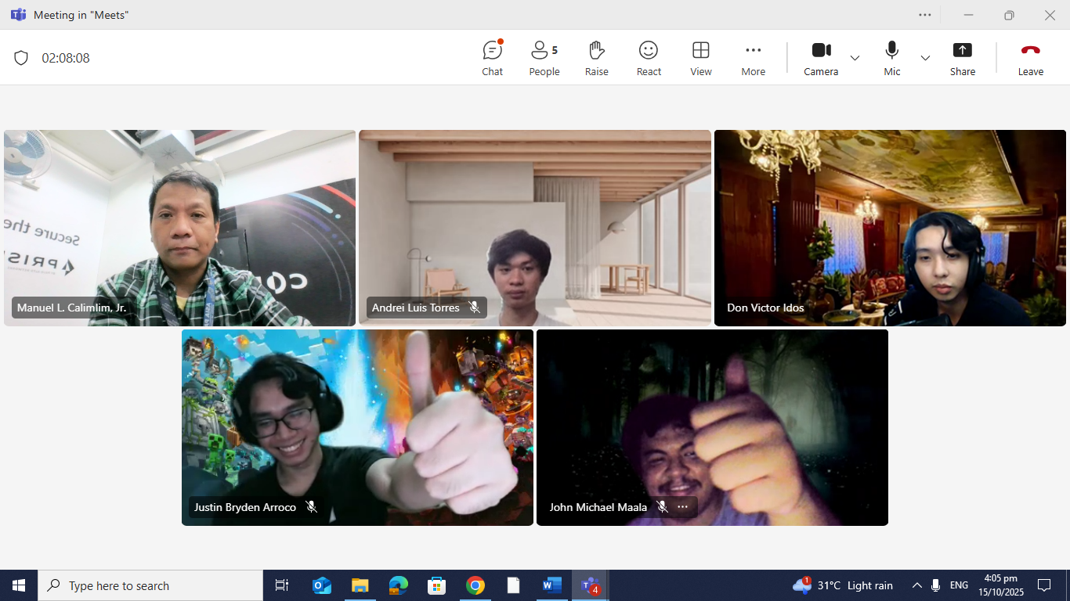
Agile Scrum Sprint 1 Ceremonies: Sprint Review
Andrei Luis Torres

Slide 35

Agile Scrum Sprint 1 Ceremonies: Retrospective
Andrei Luis Torres

Slide 36
Agile Scrum Sprint 1 Ceremonies: Retrospective
Andrei Luis Torres
Actionable Items:
Add:
Decide on Canva vs Draw.io
Add AI for meetings
Make dictionary of terms
Less:
Work more, do not procrastinate
Notes when discussing things especially with disagreement. AI tool to probably help with that
Set Schedules for working
More:
Daily Scrum Updates
Bi-weekly meeting with the clients
Start using GitHub and OpenProject more seriously
Cross check each others work

Slide 37
RESOURCE PAGES VVV

Slide 38

Company Overview
Innovating for a sustainable future
Presenter Name

Slide 39
Agenda
Company History
Market Position
Mission and Vision
Governance and CSR
Core Values
Future Goals
Business Model

Slide 40




Company History
About us: Foundation, Milestones, and Growth

Slide 41

Foundation
Our company was founded in 2001 with a vision to innovate and provide groundbreaking solutions in the tech industry. The founders, inspired by the rapid advancements in technology, envisioned a company that would not only participate in the tech revolution but lead it. This vision laid the foundation for what has become a leading organization in our field. Over the years, our commitment to innovation and quality has driven our growth and solidified our position as a trusted leader in technology solutions.

Slide 42




Milestones
Initial Public Offering (IPO)
International Expansion
In 2005, our company went public, marking a significant milestone in our growth trajectory.
By 2015, our company had established a global footprint, opening offices in major markets around the world.
Strategic Partnerships
Product Innovation
In 2010, we formed key strategic partnerships that enhanced our market presence and broadened our technological capabilities.
In 2018, we launched our flagship product, which revolutionized the industry and set new standards for quality and performance.

Slide 43
Company Growth
Early Funding
Business Model Pivot
Initial funding was crucial, fueling growth, R&D investments, and enabling innovation
and market expansion.
In 2010, we adapted our business model for market changes, boosting customer satisfaction and competitiveness.
Strategic Acquisitions
Target Market Focus
Strategic acquisitions boost capabilities, broaden products, and propel growth
and market dominance.
Focusing on specific markets lets us tailor products for unique needs,
increasing satisfaction and loyalty.

Slide 44
Mission and Vision
What we are and what we do

Slide 45

Mission Statement
Our mission is to harness cutting-edge technology to create innovative solutions that empower businesses and individuals. We are committed to excellence, quality, and delivering value to our stakeholders.

Slide 46
Vision Statement
Sustainability and Impact
Future-oriented Goals
We envision a future where our solutions contribute to sustainable development. Our commitment to environmental and social responsibility is integrated into
our long-term strategic plans.
Our vision encapsulates our aspirations to be a leader in technology innovation. We aim to set benchmarks in quality, innovation, and customer satisfaction over the next decade, driving transformation across industries.
Global Presence
Technological Leadership
Expanding our global footprint is a key component of our vision. We aim to serve diverse markets and leverage local insights to tailor our offerings, fostering inclusive growth.
We strive to be at the forefront of technological advancements, pioneering new paths in the tech industry. Our focus on research and development is critical to maintaining our leadership position.

Slide 47




Core Values
Fundamental Beliefs and Principles

Slide 48

Value Statement
Innovation
Integrity
We prioritize innovation in every aspect of our operations, continuously seeking new ways to enhance our products and services.
We uphold the highest ethical standards, ensuring transparency and accountability in our interactions with stakeholders and the communities we serve.
Sustainability
Customer Focus
We strive to minimize our environmental impact and promote sustainable practices, aligning our operations with global efforts to combat climate change.
Our customer-centric approach ensures that we deliver exceptional value and build long-term relationships based on trust and mutual respect.

Slide 49
Cultural Integration
Integrating our core values into the company culture is a strategic priority. By embedding these values into our policies, procedures, and daily activities, we create a cohesive environment that encourages employee engagement and alignment with our strategic goals.

Slide 50
Business Model
Revenue-generating Tactics and Operational Strategy

Slide 51




Comprehensive Revenue Streams
Product
Sales
Subscription
Services
Consulting and
Support
Partnerships and Licensing
Our primary revenue stream is generated from the direct sales of our innovative products.
We offer subscription-based services, providing customers with access to our latest updates and features.
Offering consulting services generates additional income while strengthening client relationships.
Strategic partnerships and licensing agreements enable us to expand our market reach.

Slide 52

Operational Strategy
Efficiency
Innovation
We leverage advanced data analytics and AI to optimize our processes, reduce costs, and enhance decision-making. By embracing digital transformation, we streamline operations and improve customer engagement.
Strategic partnerships further enhance our operational capabilities, allowing us to access new technologies and markets.
Sustainability
We are committed to sustainable practices, integrating eco-friendly initiatives into our operations to minimize environmental impact.

Slide 53




Market Position
Industry Standing of the Company

Slide 54
Industry Overview
The current industry landscape is characterized by rapid technological advancements and increasing competition. Key trends such as the integration of artificial intelligence and machine learning, digital transformation, and a growing emphasis on sustainability are reshaping market dynamics. Companies are leveraging these technologies to enhance operational efficiency and offer personalized customer experiences.

Slide 55
Governance and CSR
Company's Governance Structure and CSR Initiatives

Slide 56




Corporate Governance
Board Diversity
Ethical Framework
Sustainability Integration
Technology
Utilization
Diverse boards bring varied perspectives, enhancing decision-making and strategic oversight.
We have established robust ethical guidelines that inform our governance practices.
Sustainability is woven into our governance framework, supporting transparency and accountability.
We leverage technologies such as AI and blockchain to enhance transparency and efficiency.

Slide 57

CSR Initiatives
Our commitment to corporate social responsibility (CSR) is reflected in a range of initiatives that address environmental, social, and economic challenges, align our CSR goals with community needs and global sustainability standards.

Slide 58




Future Goals
Short-term Goals & Long-term Vision

Slide 59
Short-term Objectives
01
02
03
04
Market Expansion
Technological Advancement
Sustainability Initiatives
Innovation Culture
Target entering two new international markets within the next 12 months.
Focus on integrating AI and ML to enhance operational efficiency and product offerings.
Implement comprehensive sustainability practices across all operations.
Cultivate a culture of innovation to support rapid development of new ideas.

Slide 60
Long-term Vision
Our long-term vision is to lead the industry through continuous innovation and exceptional value delivery. We aim to expand our impact by developing cutting-edge solutions for emerging challenges. By fostering a culture of excellence and collaboration, we strive for sustainable growth and success. Our commitment to meeting clients' evolving needs and staying ahead of trends drives our strategic planning and forward-thinking approach.

Slide 61

Thank you

